Slide 1
CSIR – MARNPD System
By The_Gruners

Slide 2
Function Requirements
Number Plate Detection
Local Session Storage
Data Retrieval
Detection History
Web Application (Data Management)

Slide 3
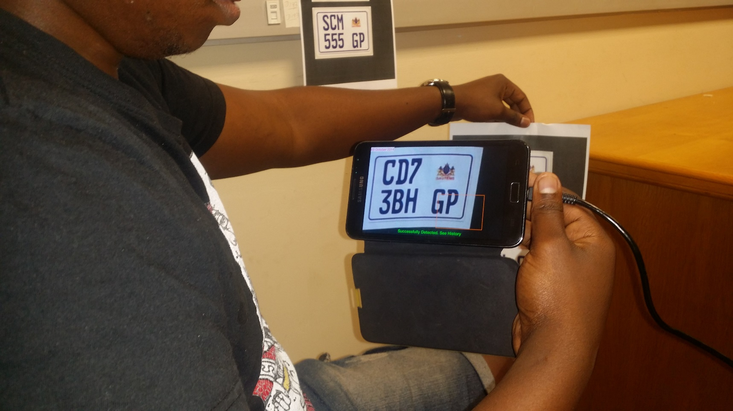
Implemented & Integrated Functionality
Number Plate Detection

Slide 4
Implemented & Integrated Functionality
Local Session Storage

Slide 5
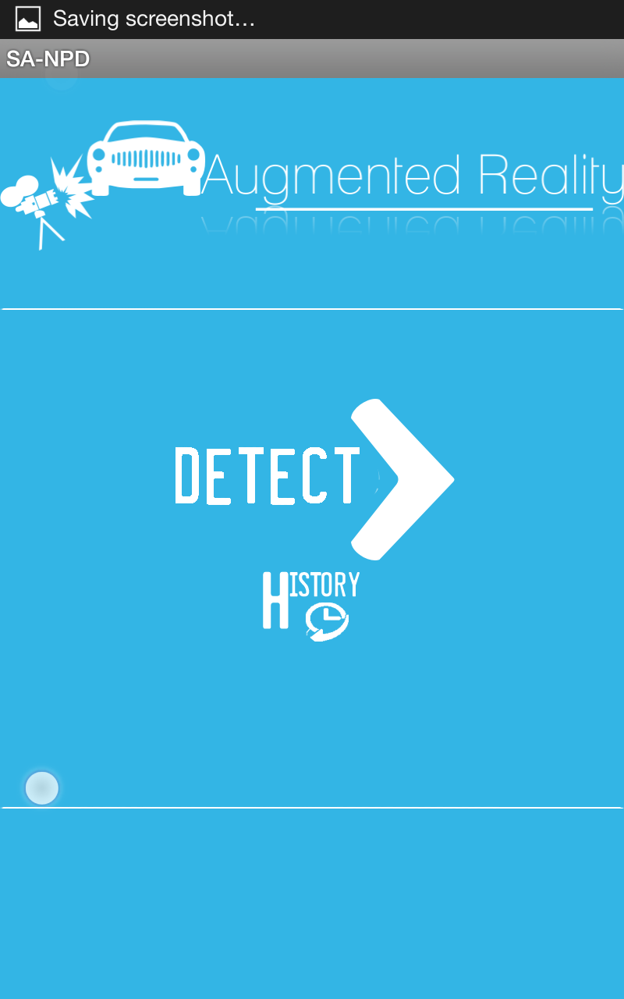
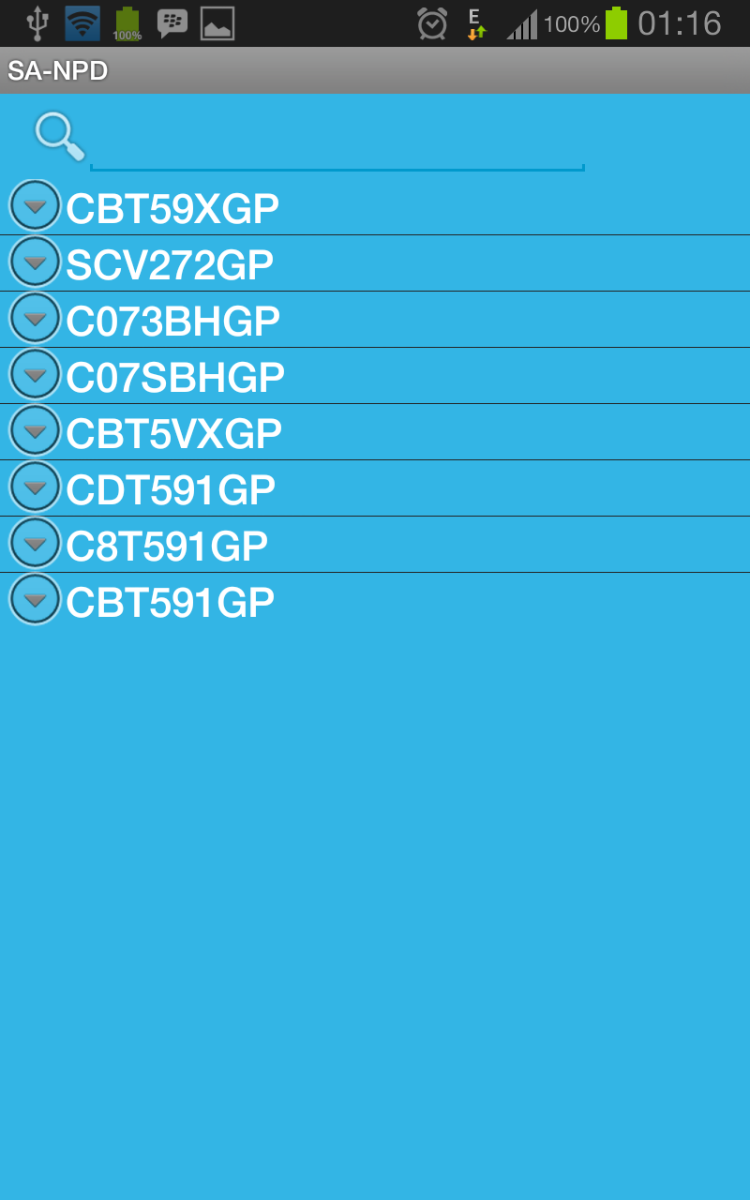
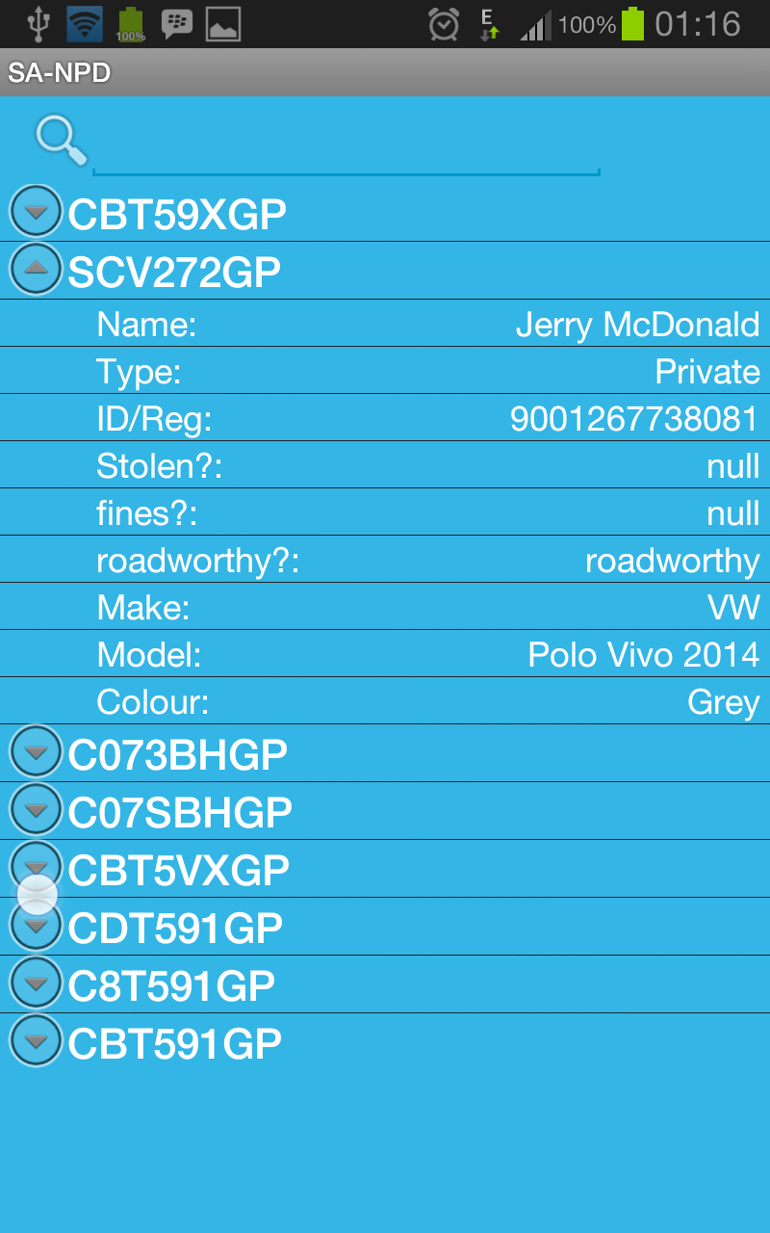
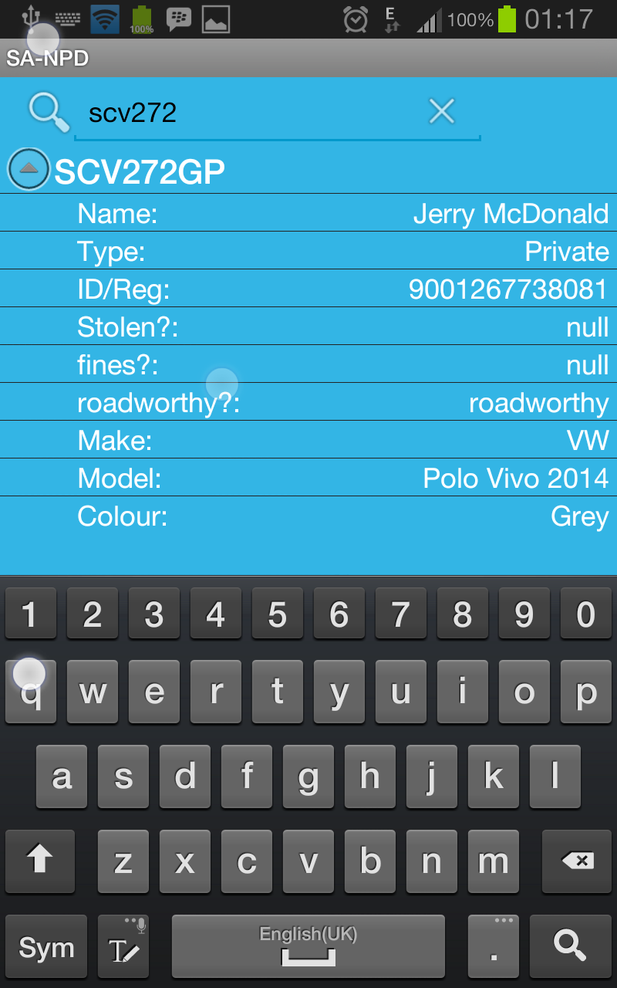
Implemented & Integrated Functionality
Detection History

Slide 6

Implemented & Integrated Functionality
Web Application (Data Management)

Slide 7
Number Plate Detection Tests (July-October)

Slide 8
OPEN CV Flaws
JNI unhandled exceptions cannot be handled on the Android App
Not Augmented Reality (We plugged Vuforia back for Augmented Reality)
User must install OPENCV Manager on Android phone for OPENCV to work

Slide 9

Quality Requirements
Performance
Accuracy (Neural Network Train Sets)
Auditability (Audit logs for all operations)
Maintainability (Decoupling System Layers)
Usability (Short & Simple function Processes)

Slide 10
Algorithms
Optical Character Recognition using Neural Networks

